Slide 1



An AI-Based Smart Emergency Crowd Alert System for Real-Time Crowd Density Monitoring and Risk Prediction Using Computer Vision
CSA 0808 – PYTHON PROGRAMMING
UNDER THE GUIDANCE OF:
Dr. PONMANIRAJ.S
PRESENTED BY:
VIJIYA PRIYA S.A(192524417)
HARINI SREE J (192521189)
VAISHNAVI D (192524143)

Slide 2
ABSTRACT
Large public gatherings often face overcrowding and various safety risks. The proposed system uses Artificial Intelligence (AI) and Computer Vision to monitor crowds in real time. CCTV cameras capture live video streams, while the AI system detects people and estimates crowd density accurately. It can identify and predict potential crowd-related risks before emergencies occur, allowing authorities to take preventive action. When a critical situation is detected, automatic alerts are sent to security personnel and emergency responders for quick action. This solution enhances public safety, reduces the risk of crowd-related incidents, and supports efficient smart city surveillance.

Slide 3
INTRODUCTION
Crowd management is a major challenge in public places and large events.
Overcrowding can lead to stampedes, panic, injuries, and loss of life.
Traditional monitoring relies on manual surveillance, which may miss critical situations.
AI and Computer Vision provide automated and accurate crowd analysis.
Real-time video analytics help identify overcrowded areas instantly.
Predictive technology enables authorities to take preventive action before emergencies.

Slide 4
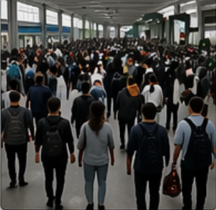
OBJECTIVES
Detect and count people using AI-based Computer Vision.
Predict crowd-related risks before emergencies occur.
Generate automatic emergency alerts for authorities.
Improve crowd management and reduce response time.
Enhance public safety and support smart city surveillance.
Monitor crowd density in real time using CCTV cameras.
Assist security personnel in effective crowd management.
Identify overcrowded areas through continuous video analysis.

Slide 5
LITERATURE SURVEY
S.NO | AUTHOR NAME | PAPER TITLE | METHOD USED | DATASET | ACCURACY | FINDINGS
1 | S. Balasubramanian et al. | Proactive Headcount and Suspicious Activity Detection using YOLOv8 (2023) | YOLOv8 Object Detection | Custom Surveillance Video Dataset | 95.4% | Achieved accurate real-time headcount detection and suspicious activity monitoring for public safety applications.
2 | Yuchao Fang, Huanli Pang | An Improved Pedestrian Detection Model Based on YOLOv8 for Dense Scenes (2024) | Improved YOLOv8 with attention mechanism | CrowdHuman & WiderPerson datasets | 96.1% | Improved pedestrian detection accuracy in crowded and occluded environments.
3 | Abdullah N. Alhawsawi et al. | Enhanced YOLOv8-Based Model with Context Enrichment Module for Crowd Counting in Complex Drone Imagery (2024) | Enhanced YOLOv8 + Context Enrichment Module | VisDrone & DroneCrowd datasets | 97.2% | Increased crowd counting accuracy in aerial images with dense crowds

Slide 6
PROBLEM STATEMENT
The existing traditional crowd monitoring system mainly relies on manual monitoring by security personnel, which can lead to human errors and may fail to identify overcrowded areas. Monitoring large crowds continuously is difficult, and incidents are often detected only after they occur, resulting in delayed emergency responses and alerts. The traditional system also provides limited decision support to authorities, increasing the risk of stampedes and public accidents. To overcome these limitations, the proposed AI-Based Smart Emergency Crowd Alert System uses Artificial Intelligence and Computer Vision for automated and continuous monitoring.
The system analyzes live CCTV video streams, detects and counts people accurately in real time, identifies potential crowd risks before emergencies occur, and automatically generates instant emergency alerts.
It also provides real-time insights to authorities for faster decision-making, thereby reducing crowd-related risks and improving overall public safety.

Slide 7


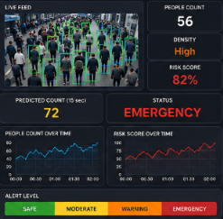







SYSTEM ARCHITECTURE
1) Input Layer
2) Video Processing and person Detection
3) Crowd Analysis and risk prediction
4)Dashboard and alert system
Crowd density Calculation
Crowd growth analysis
YOLO v8
(Person Detection)
Risk Score calculation
People counting and Tracking
Risk prediction
(Future Score)
1)Monitors system
2)View logs
3)Generate reports
System admin
6) Alert Generation
(People count,Risk score,Alerts,
Time,Date)
5)Database and logging

Slide 8
MODULE 1: CROWD DETECTION AND MONITORING
Purpose
Detect and monitor crowd density in real time using AI and Computer Vision.
Identify people and overcrowded areas for continuous crowd surveillance.
Functions
Capture live video from CCTV cameras.
Detect and count people using AI models (YOLO).
Estimate crowd density continuously.
Identify overcrowded areas.
Track crowd movement for continuous monitoring.

Slide 9
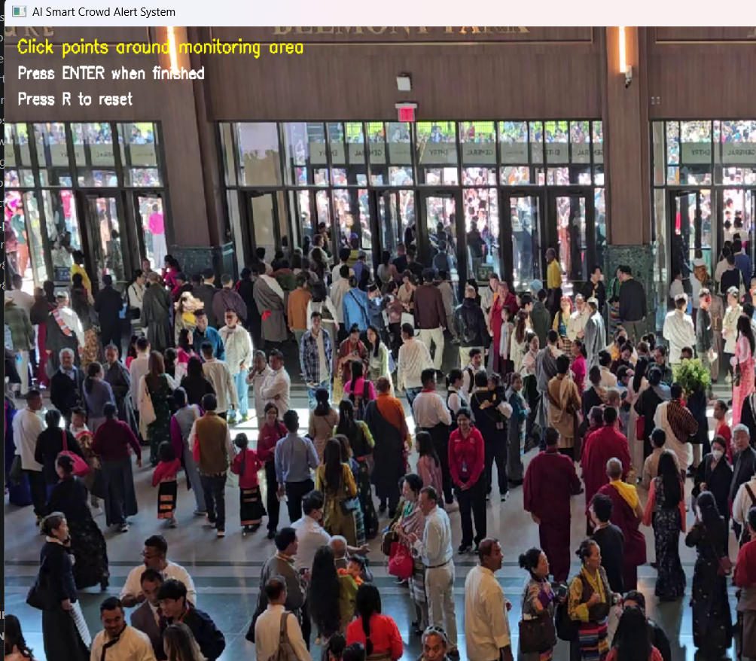
OUTPUT

Slide 10
MODULE 2: EMERGENCY RISK ANALYSIS
AND ALERT SYSTEM
Purpose
Analyze crowd conditions to identify potential emergency situations.
Predict crowd-related risks and generate timely alerts for authorities.
Functions
Analyze crowd density and movement patterns.
Classify risk levels (Low, Medium, High).
Detect abnormal crowd behavior.
Generate automatic emergency alerts.
Send notifications to security personnel and emergency responders.

Slide 11
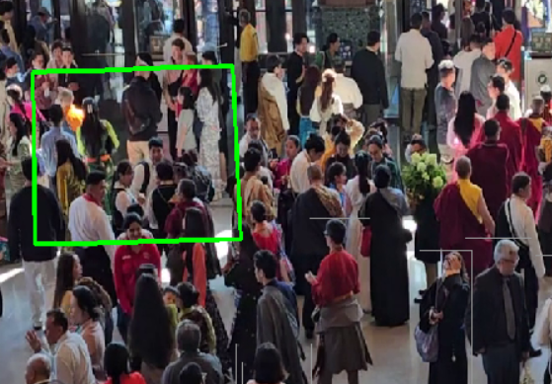
OUTPUT

Slide 12
MODULE 3: DASHBOARD AND DATA MANAGEMENT
Purpose
Provide a centralized platform for real-time crowd monitoring and system management.
Store, visualize, and analyze crowd data to support informed decision-making.
Functions
Display live crowd statistics and CCTV monitoring.
Show crowd density levels and emergency risk status.
Store historical crowd monitoring data.
Generate reports and data analytics.
Provide a dashboard for authorities to monitor and manage crowd situations.

Slide 13
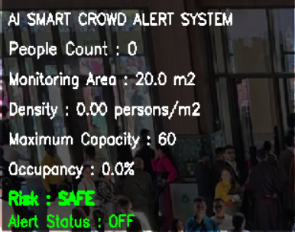
OUTPUT

Slide 14
REFERENCES
• Parashar, P., Bhartiya, P., & Shriwastava, S., "Intelligent Crowd Monitoring and Early Warning Framework for Stampede Prevention Using YOLOv8m and CNN-LSTM Architecture," International Journal of Computer Trends and Technology, Vol. 74, No. 6, 2026.
• Hong, S. C., & Kim, E. M., "Analysis of Crowd Risk Based on Orthoimage Combining Deep Learning and Kernel Density Estimation," Journal of the Korean Society of Surveying, Geodesy, Photogrammetry and Cartography, 2026.
• Krishna Reddy, K., Ramya, T., Ramesh, Y., & Rao Pyla, J. V. G., "Real-Time Stampede Risk Prediction from Crowd Videos Using YOLOv8 and Spatio-Temporal Modeling," International Journal of Computational Science and Engineering Research, 2026.
• Rao, M. V. G., Kartheesan, L., & Ravi Teja, T., "Smart AI-Driven Crowd Density Monitoring and Stampede Prevention System," Atlantis Press Proceedings, 2026.
• Khan, M. A., Menouar, H., & Hamila, R., "Visual Crowd Analysis: Open Research Problems," arXiv, 2023.

